Slide 1
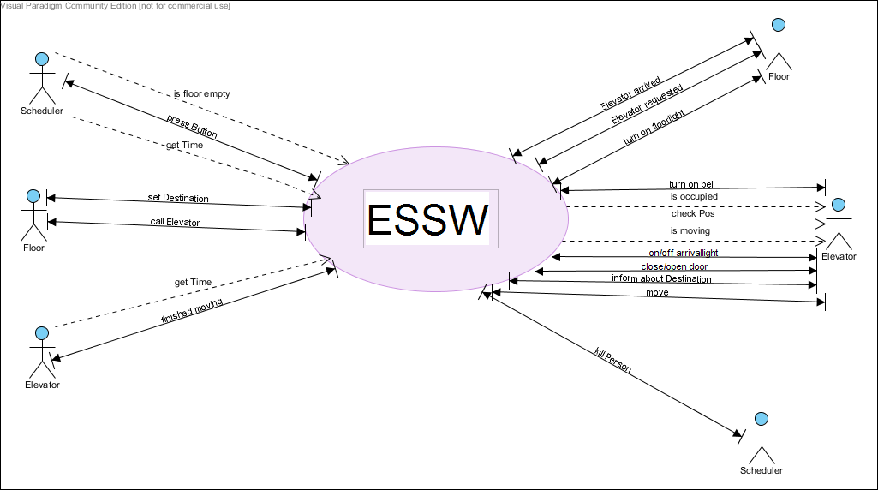
Estimation

Slide 2
14 Criteria
1 | Data Communication | 0
2 | Distributed data processing | 0
3 | Performance | 1
4 | Heavily used configuration | 0
5 | Transaction rate | 0
6 | Online data entry | 0
7 | End User efficiency | 0
8 | Online update | 0
9 | Complex processing | 0
10 | Reusability | 1
11 | Installation ease | 0
12 | Operational ease | 5
13 | Multiple sites | 3
14 | Facilitate change | 0
Gesamt | Fi | 10

Slide 3
Input | 5 | x3 | 15
Output | 8 | x4 | 32
Query | 6 | x3 | 18
 |  |  | =
 |  | ct | 65
Java => 53LOC/FP | Fi=10 | ct=65
FP=ct*(0,65+0,01xFi) | => FP=48 | =>LOC=48*53 | LOC=2554
 |  |  | =>KLOC=2,554

Slide 4
COCOMO
Organic => | a = 2,4 | b = 1,05 | c = 2,5 | d = 0,38
Effort (person month) | E= a*L^b | E=6.4
Development time (month) | D= c*E^d | D=5,06
People required | P=E/D | P=1.26
E =6 | KLOC = | 2,393 | E = 12 | KLOC = | 4,63
D= 1 |  |  | D = 2
6=E/1 |  |  | 6=E/2

